Slide 1
Queue

Slide 2
Queues
Queue: a collection where elements are added at one end (the rear or tail of the queue) and removed from the other end (the front or head of the queue)
A queue is a FIFO (first in, first out) data structure
Any waiting line is a queue:
The check-out line at a grocery store
The cars at a stop light
An assembly line

Slide 3
Conceptual View of a Queue
Adding an element
Front of queue
New element is added to the rear of the queue

Slide 4
Conceptual View of a Queue
Removing an element
New front element of queue
Element is removed from the front of the queue

Slide 5
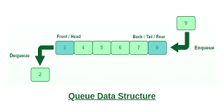
Conceptual View of a Queue

Slide 6
Applications of Queue
Processor Scheduling
All types of customer services
Printer Server routines.

Slide 7
Operations on a Queue(ADT)
Operation | Description
dequeue | Removes an element from the front of the queue
enqueue | Adds an element to the rear of the queue
first | Examines the element at the front of the queue
isEmpty | Determines whether the queue is empty
size | Determines the number of elements in the queue
isFull | Determines whether the queue is Full

Slide 8
Types of queue 1.Simple Queue 2.Circular Queue 3.Priority Queue 4.Dequeue(Double Ended Queue)

Slide 9
Simple Queue A simple queue are the general queue that we use on perform insertion and deletion on FIFO basis i.e. the new element is inserted at the rear of the queue and an element is deleted from the front of the queue Applications of Simple Queue 1.CPU scheduling 2.Disk Scheduling 3.Synchronization between two process.

Slide 10
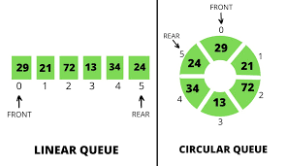
Circular Queue Circular queue is a type of queue in which all nodes are treated as circular such that the first node follows the last node. In this type of queue operations are performed on first in first out basis i.e the element that has inserted first will be one that will be deleted first.

Slide 11
Priority Queue Priority Queue is a special type of queue in which elements are treated according to their priority. Insertion of an element take place at the rear of the queue but the deletion or removal of an element take place according to the priority of the element. Element with the highest priority is removed first and element with the lowest priority is removed last.

Slide 12
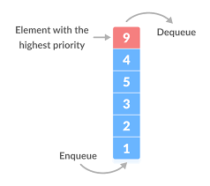
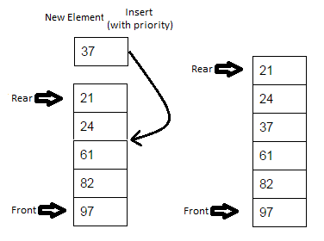
Fig.1
Fig.2

Slide 13
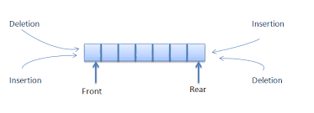
Double Ended Queue Double ended queue are also known as deque . In this type of queue insertion and deletion of an element can take place at both the ends.

Slide 14
Double Ended Queue Further deque is divided into two types:- Input Restricted Deque :- In this, input is blocked at a single end but allows deletion at both the ends. Output Restricted Deque :- In this, output is blocked at a single end but allows insertion at both the ends.

Slide 15
Implementation of a Queue
Queues can be implemented using arrays or linked lists.
Queue using Array
This requires a one-dimensional array of well-defined size.
Then insert or delete operation can be performed on that array by using the First In First Out (FIFO) property.
To do this two variables Front and Rear are used.
Front and Rear variables show the exact position from where insertion and deletion operations were performed on a one-dimensional array representation of the queue.
Initially, both the values of variable Front and Rear are
'-1' when the queue is empty

Slide 16
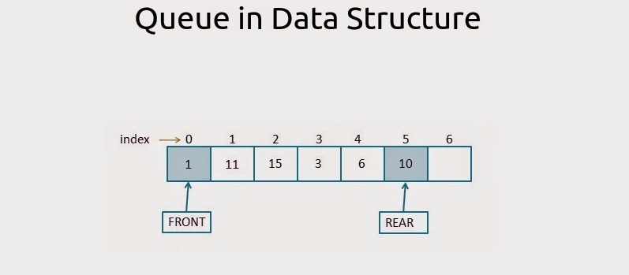

Slide 17
Insert an element in a queue
Check if the queue is already full by comparing rear to max - 1. if so, then return an overflow error.
If the item is to be inserted as the first element in the list, in that case set the value of front and rear to 0 and insert the element at the rear end.
Otherwise keep increasing the value of rear and insert each element one by one having rear as the index.
Algorithm
Step 1: IF REAR = MAX - 1 Write OVERFLOW Go to step [END OF IF]
Step 2: IF FRONT = -1 and REAR = -1 SET FRONT = REAR = 0 ELSE SET REAR = REAR + 1 [END OF IF]
Step 3: Set QUEUE[REAR] = NUM
Step 4: EXIT

Slide 18
Delete an element from the queue
If, the value of front is -1 or value of front is greater than rear , write an underflow message and exit.
Otherwise, keep increasing the value of front and return the item stored at the front end of the queue at each time.
Algorithm
Step 1: IF FRONT = -1 or FRONT > REAR Write UNDERFLOW ELSE SET VAL = QUEUE[FRONT] SET FRONT = FRONT + 1 [END OF IF]
Step 2: EXIT

Slide 19
Drawback of array implementation
Memory wastage
Deciding the array size

Slide 20
int queue_array[MAX];
int rear = - 1;
int front = - 1;
void insert()
{
int item;
if(rear == MAX - 1)
printf("Queue Overflow n");
else
{
if(front== - 1)
front = 0;
printf("Inset the element in queue : ");
scanf("%d", &item);
rear = rear + 1;
queue_array[rear] = item;
}
}

Slide 21
void delete()
{
if(front == - 1 || front > rear)
{
printf("Queue Underflow n");
return;
}
else
{
printf("Element deleted from queue is : %dn", queue_array[front]);
front = front + 1;
}
}

Slide 22
void display()
{
int i;
if(front == - 1)
printf("Queue is empty n");
else
{
printf("Queue is : n");
for(i = front; i <= rear; i++)
printf("%d ", queue_array[i]);
printf("n");
}
}

